Slide 1
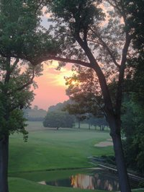

2015 RIMS/Spencer Foundation
Annual Golf Outing Philadelphia Country Club www.philadelphiacc.net
Join your peers from the Delaware Valley Chapter of RIMS for the 20th annual golf outing in support of the non-profit Spencer Educational Foundation of RIMS. The Foundation’s mission is to stimulate and assist promising students of Risk Management and Insurance through scholarships and educational grants.
Monday, September 21, 2015
9:00 AM Registration & Continental Breakfast
10:00 AM Shotgun Start
Cocktails, Hors d’oeuvres and Reception and Awards
Raffle
We will once again be holding our annual raffle which will include many amazing gifts ranging from electronics, sporting events to gift certificates at local restaurants. Tickets will be sold at registration and during the event. All proceeds will be donated to the Foundation. If you would like to contribute a prize for the raffle, please contact Jeff Jansen jeff.jansen@aon.com and he will provide further details on how to make your donation. To enter the raffle please to this website: Signup Genius
Tennis Option: If you would be interested in a tennis round robin and/or clinic please email
Sara Potter Potters@email.chop.edu. Based on the responses we will consider options and
communicate to those who have expressed interest.
The Rosenberg & Parker RIMS Trophy
The trophy will be awarded annually to the winning foursome based upon pro shop’s calculations. The names of the winners will be engraved on the perpetual cup and each member of the foursome will receive a trophy.
Cocktails and Hors d’oeuvres Reception Only - $50
Non –Golfers: Join us for Cocktails, Hors d’ ouevres and great conversation!
Available Promotions
Tee Sponsorships, Prizes & Giveaways, Buffet Lunch, Cocktail and Hors D’oeuvres and Reception Signage Recognition in Program and day of Event
For additional information: Jeff.Quinn@alliedBarton.com Contact or 484-351-1430

Slide 2

2015 RIMS/Spencer Foundation
Annual Golf Outing- Official Entry Form
Philadelphia Country Club www.philadelphiacc.net
Please Print (photocopy this form for additional players)
Foursome Sponsor..........................$1,500
Single Sponsor..........................$375
Sponsor: __________________________________
Company Name: ____________________________________
Business Address ___________________________________
Business Telephone: _________________________________
Business E- Mail: ____________________________________
Corporate Tee Sponsor...............................$500
Other Sponsorship Levels * see full descriptions next page
Please provide a high resolution Logo for use
Corporate PLATINUM Sponsor...............$2,500
Corporate GOLD Sponsor.......................$1,500
Corporate SILVER Sponsor.....................$1,000
Corporate BRONZE Sponsor...................$1,000
Names and Company
1. ____________________________________
2. ____________________________________
3. ____________________________________
4. ____________________________________
Each group will be provided a forecaddie. If you would like a regular caddie to carry bags, at your expense, please check here Total for golf & Sponsorship: $ ___________________
Cocktails and Hors d’oeuvres Reception Only……….…....$50
Reservations accepted with a check payable to RIMS/Spencer Golf Tournament
(Tax ID #: 58-1420617)
To guarantee your participation, please return this for by Friday, Sept. 4, 2015
Spencer Golf Tournament
Anne Ferrara
c/o Marsh USA Inc.
1717 Arch Street, Suite 1100 Philadelphia PA 19103-2797
(215) 246-1303 FAX (215) 246-1387

Slide 3
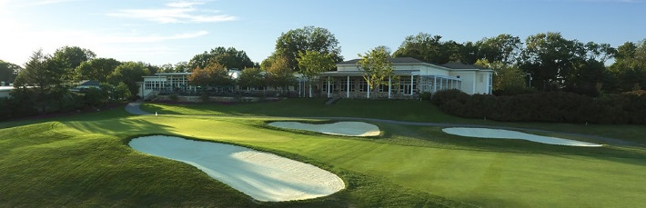
Sponsorship Levels and Descriptions
PLATINUM:
Sponsorships includes two complimentary “golfers”
Full back page advertisement in the Outing brochure
Large signage/banner noting your firm’s sponsorship displayed prominently throughout the clubhouse, and
Acknowledgement on the Delaware Valley RIMS website for 12 months.
GOLD:
Sponsorship includes one complimentary “golfer”
Half page advertisement in the Outing brochure
Smaller signage in the Clubhouse/Registration areas and
Acknowledgement on the Delaware Valley RIMS website for 12 months.
SILVER:
Sponsorship includes a half page advertisement in the Outing brochure
Table top signage in the dining/happy hour area before and following the event and
Acknowledgement on the Delaware Valley RIMS website for 12 months.
BRONZE:
Sponsorship includes a half page advertisement in the Outing brochure and
Acknowledgement on the Delaware Valley RIMS website for 12 months.
Reception:
Reception sponsors (cost is $1,000) will have their company’s logo prominently displayed at reception.
LUNCH:
Lunch sponsors ($750) will have their company’s logo prominently displayed at lunch.
GOLF CARTS:
Golf cart sponsors ($1,000)
Hole Sponsor
Hole in one vehicle or other prizes, cost varies based on items.

